Slide 1
Packet Classification
Masoud Sabaei
Associate professor
Department of Computer Engineering,
Amirkabir University of Technology

Slide 2
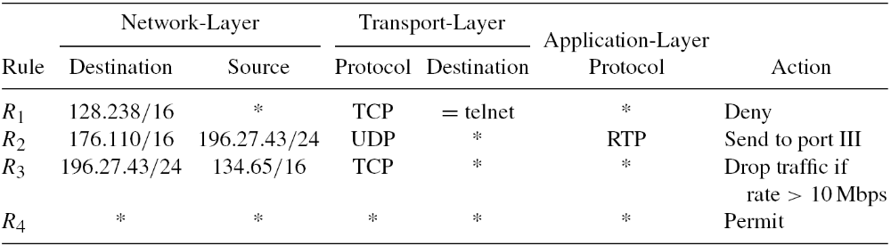
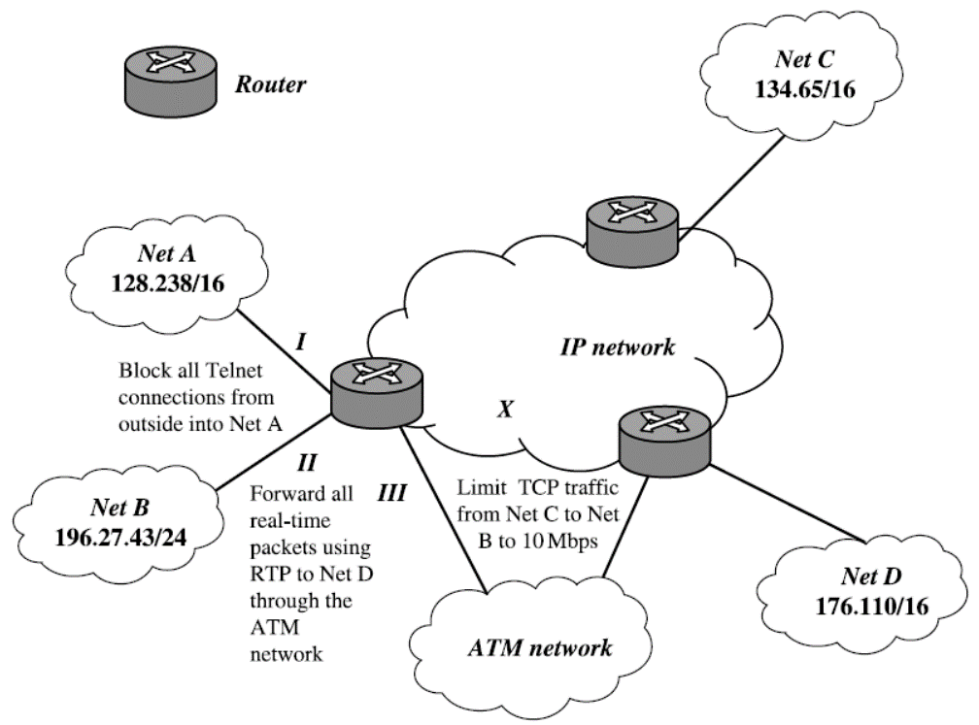
Classifier Example
Packet Filtering. Rule R1 blocks all telnet connections from outside into Net A, which may be a private research network.
Policy Routing. Rule R2 enables the router to forward all real-time traffic using real-time transport protocol (RTP) in the application layer from Net B to Net D through the ATM network at the bottom of previous Figure.
Traffic Policing. Rule R3 limits the total transmission control protocol (TCP) traffic rate from Net C to Net B up to 10 Mbps

Slide 3
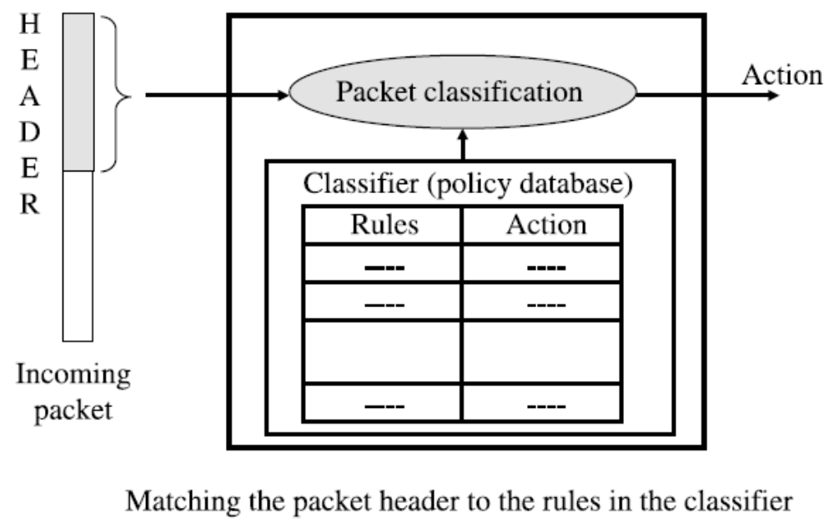
Packet Classification

Slide 4
Packet classification
1. A classifier C consists of N rules, Rj, 1 ≤ j ≤ N, where Rj is composed of three entities:
  (a) A regular expression Rj[i], 1 ≤ i ≤ d, on each of the d header fields of a packet.
  (b) A number, Pri(Rj), indicating the priority of the rule in the classifier.
  (c) An action, referred to as Action(Rj).
2. An incoming packet P with the header considered as a d-tuple (P1, P2, . . . , Pd) is said
to match Rj , if and only if, Pi matches Rj[i], where 1 ≤ i ≤ d.
3. Given an incoming packet P and thus the d-tuple, the d-dimensional packet classification problem is to find the rule Rm with the highest priority among all the rules Rj matching the d-tuple.

Slide 5
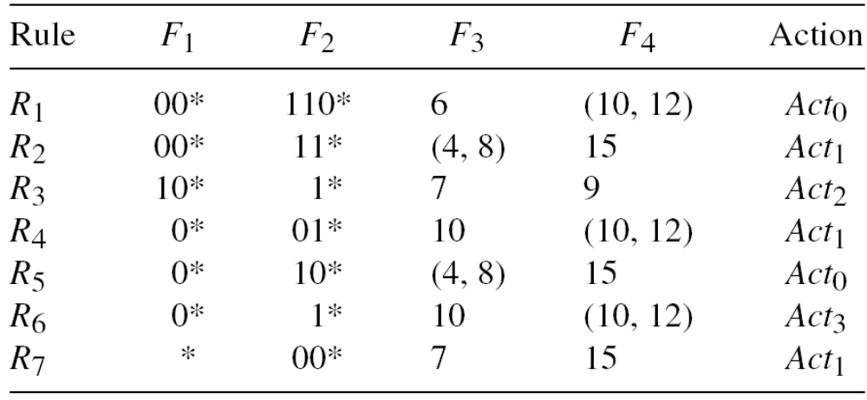
Example Classifier

Slide 6
Performance Metrics
Search Speed,
Storage Requirement,
Scalability in Classifier Size,
Scalability in the Number of Header Fields,
Update Time,
Flexibility in Specification.

Slide 7
Packet Classification Schemes
Trie-based Classifications,
Geometric Algorithms,
Heuristic Algorithms,
TCAM-based Algorithms.

Slide 8
Trie-based Classifications
Hierarchical Tries
Set-Pruning Trie
Grid of Tries
Extending Two-Dimensional Schemes
Field-Level Trie Classification (FLTC)

Slide 9
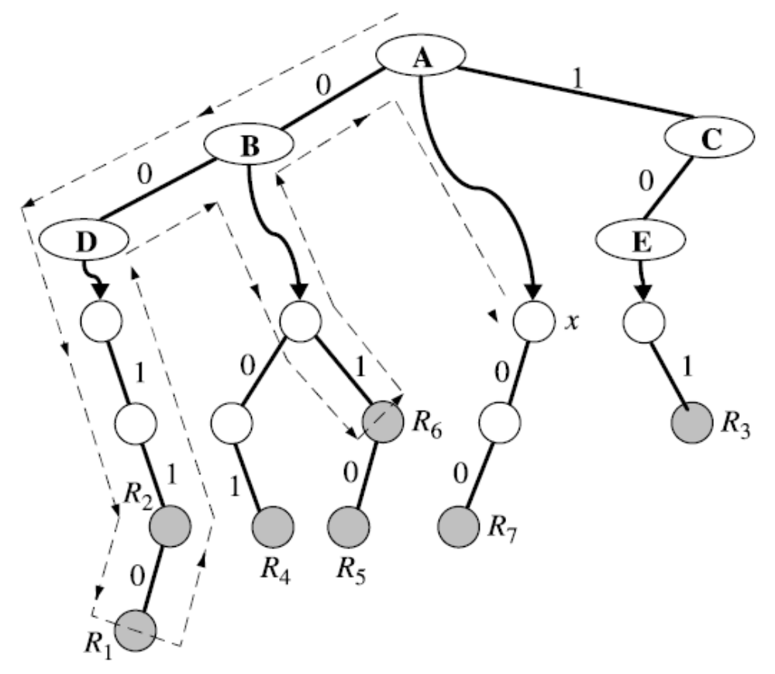
Hierarchical Tries

Slide 10
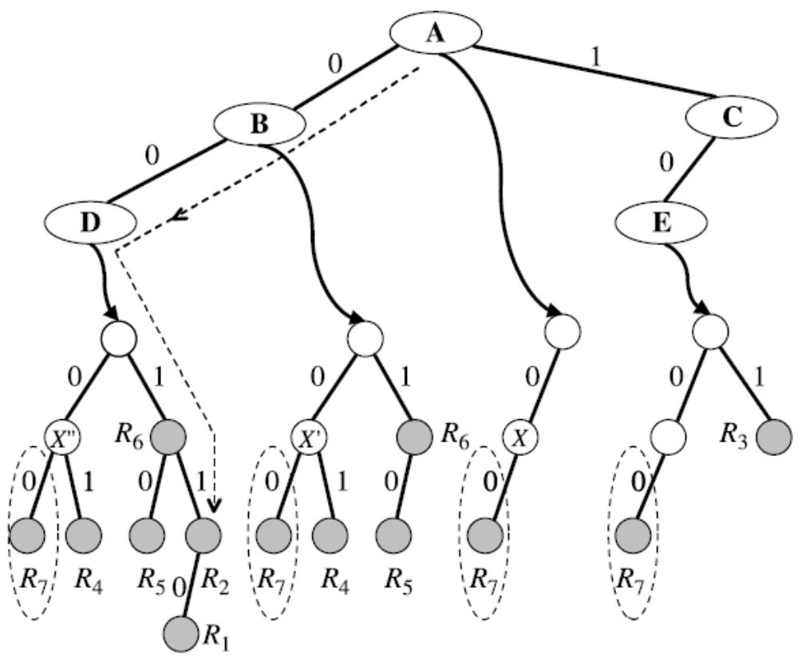
Set-Pruning Trie

Slide 11
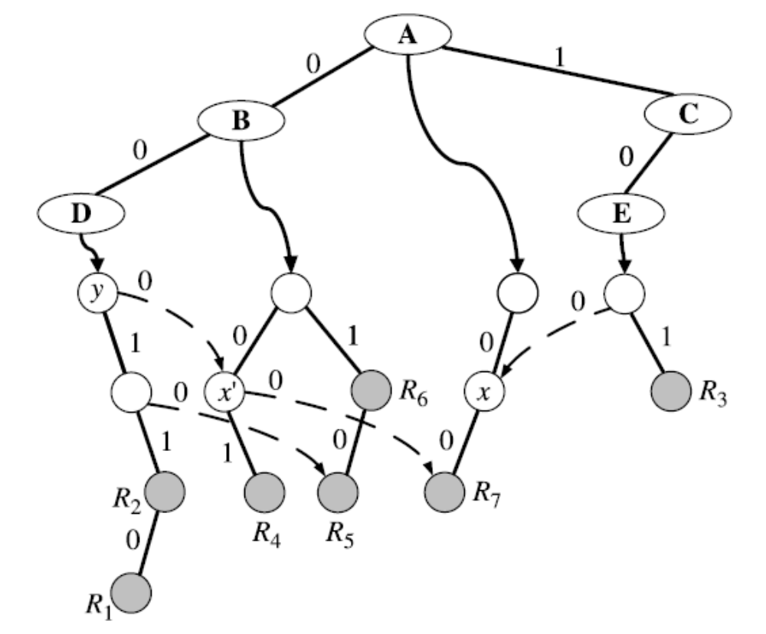
Grid of Tries

Slide 12
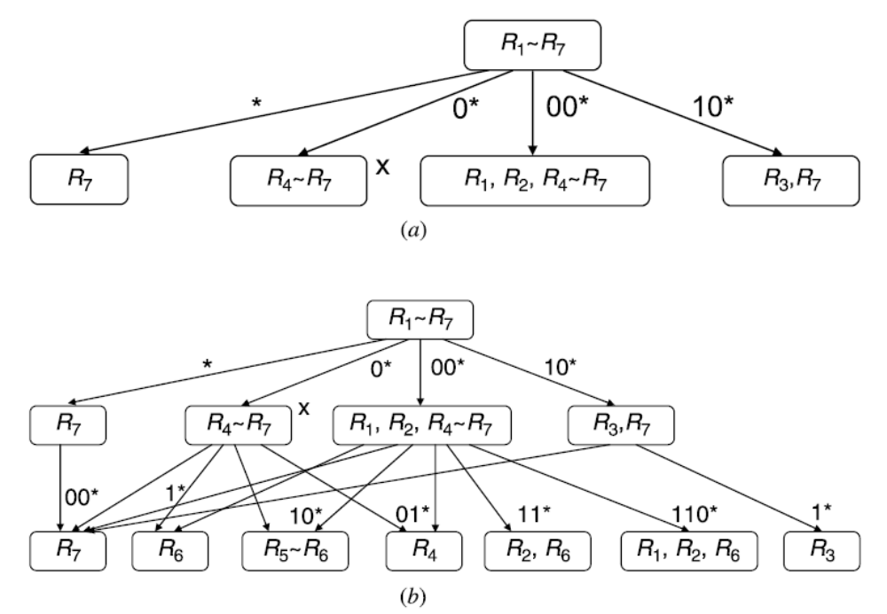
Field-Level Trie Classification (FLTC)

Slide 13
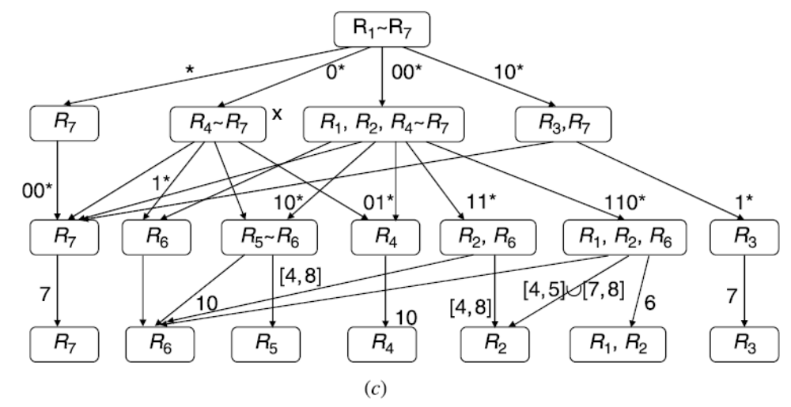
Field-Level Trie Classification (FLTC)

Slide 14
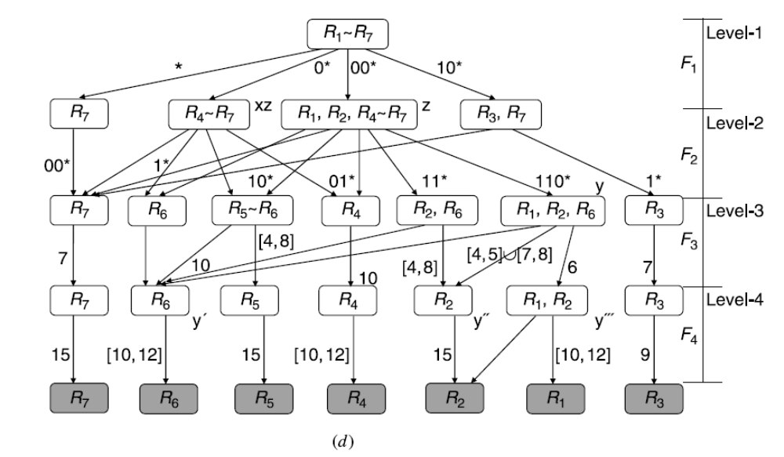
Field-Level Trie Classification (FLTC)

Slide 15
GEOMETRIC ALGORITHMS
Cross-Producting Scheme
Bitmap-Intersection
Parallel Packet Classification (P²C)
Area-Based Quadtree
Hierarchical Intelligent Cuttings
HyperCuts

Slide 16
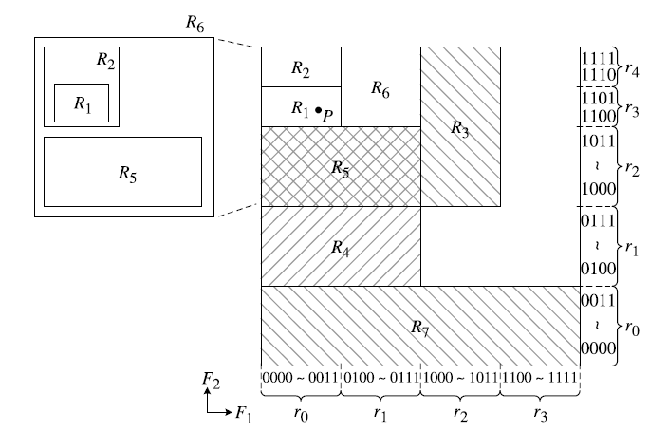
GEOMETRIC ALGORITHMS

Slide 17
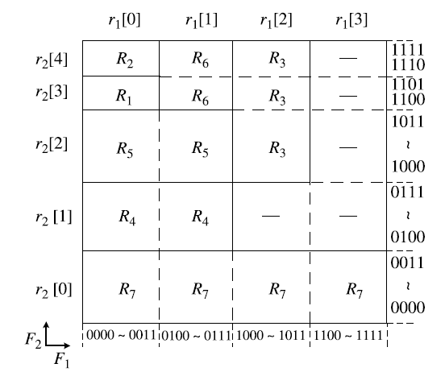
Cross-Producting Scheme

Slide 18
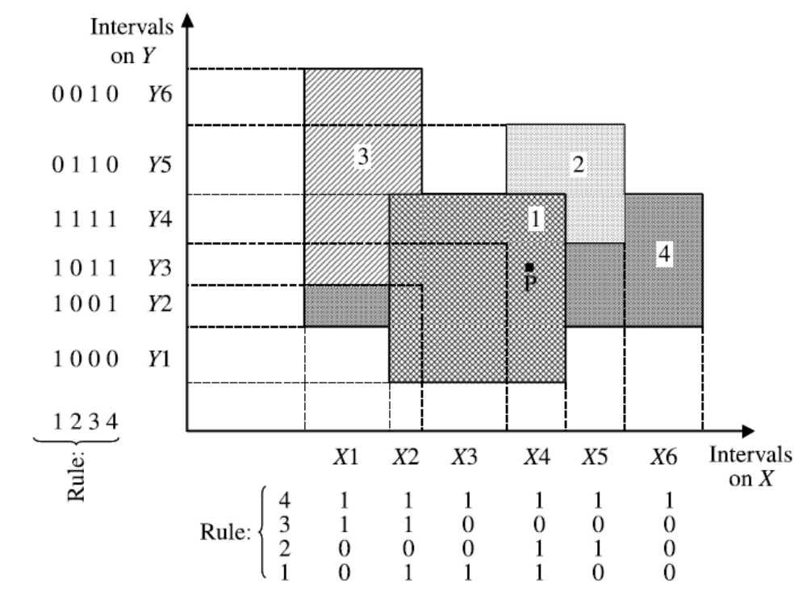
Bitmap-Intersection

Slide 19
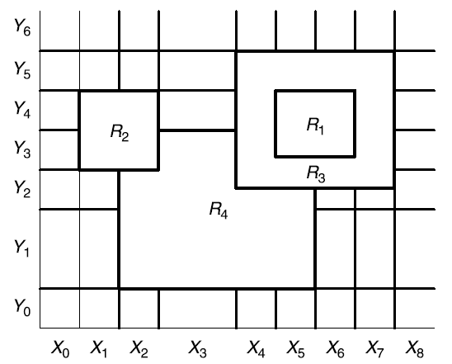
Parallel Packet Classification (P²C)

Slide 20
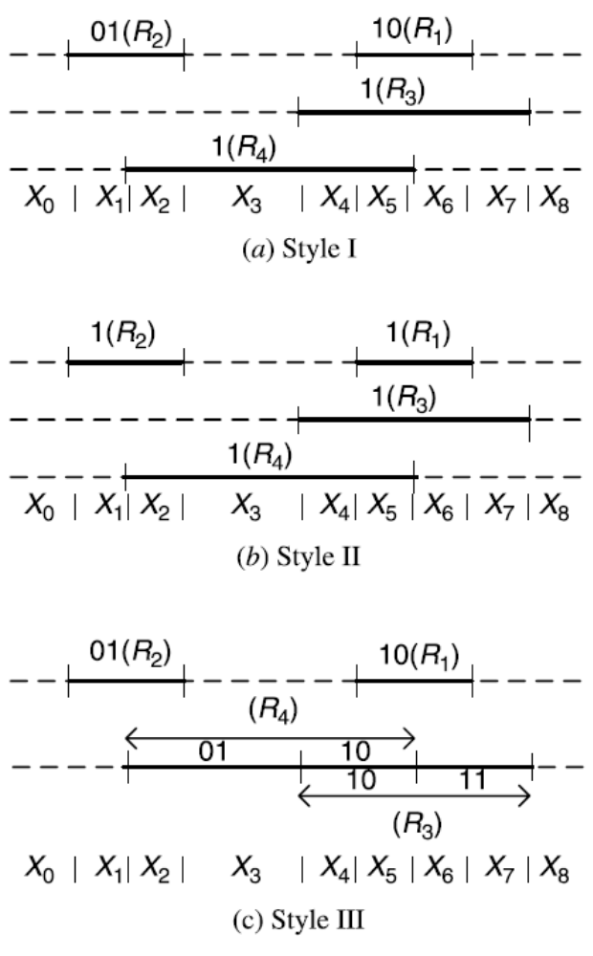
Parallel Packet Classification (P²C)

Slide 21
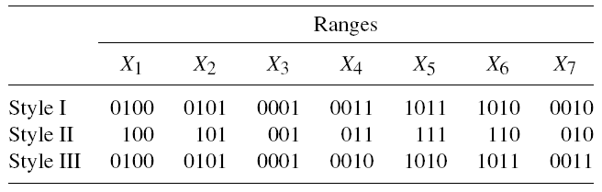
Parallel Packet Classification (P²C)
Intermediate Result Vectors for the Range Hierarchies

Slide 22
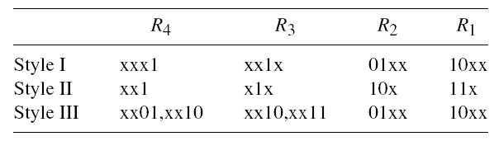
Parallel Packet Classification (P²C)
Ternary-Match Conditions for the Range Hierarchies

Slide 23
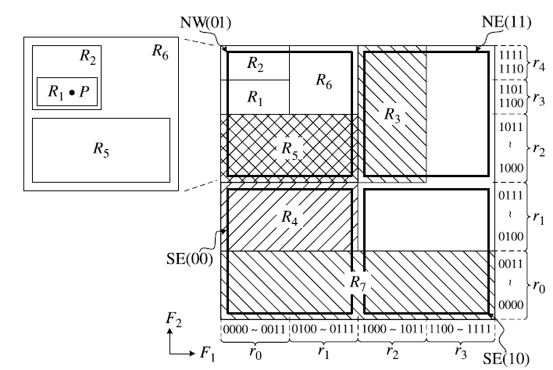
Area-Based Quadtree

Slide 24
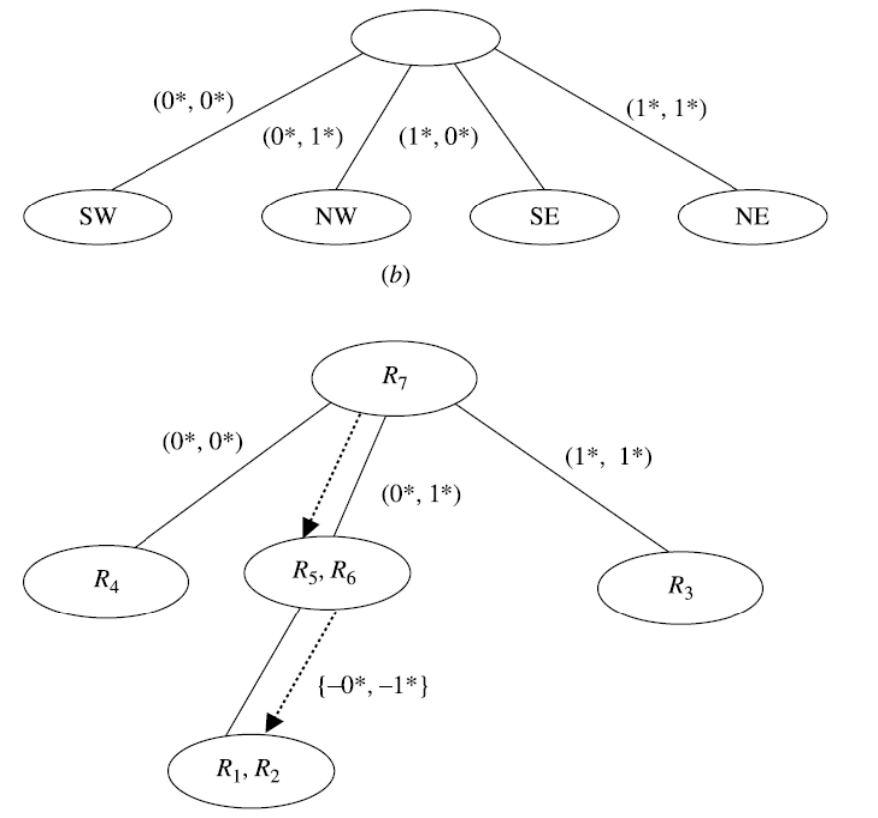
Area-Based Quadtree

Slide 25
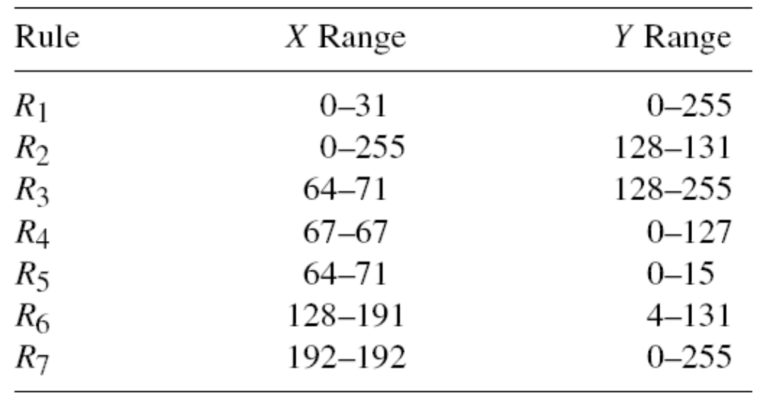
Hierarchical Intelligent Cuttings
Rule Set Example with Two
Dimensions in Ranges

Slide 26
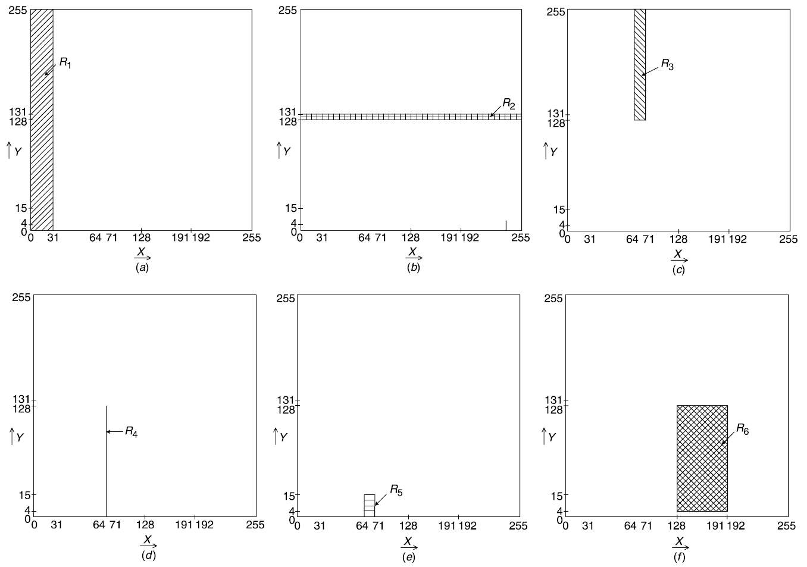
Hierarchical Intelligent Cuttings Geometrical representation of the seven rules in the table (a) R1; (b) R2; (c) R3; (d) R4; (e) R5; ( f ) R6.

Slide 27
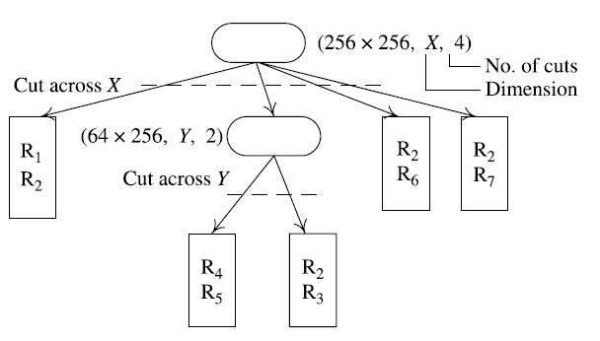
Hierarchical Intelligent Cuttings

Slide 28
Heuristic Algorithms
Recursive Flow Classification,
Tuple Space Search.

Slide 29
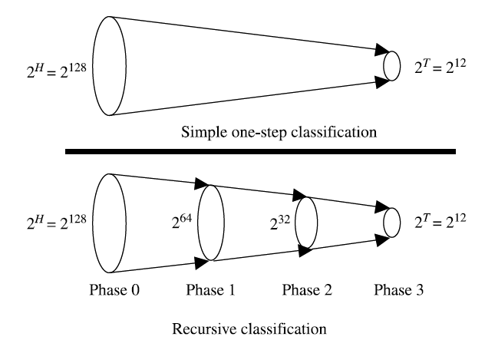
Recursive Flow Classification

Slide 30
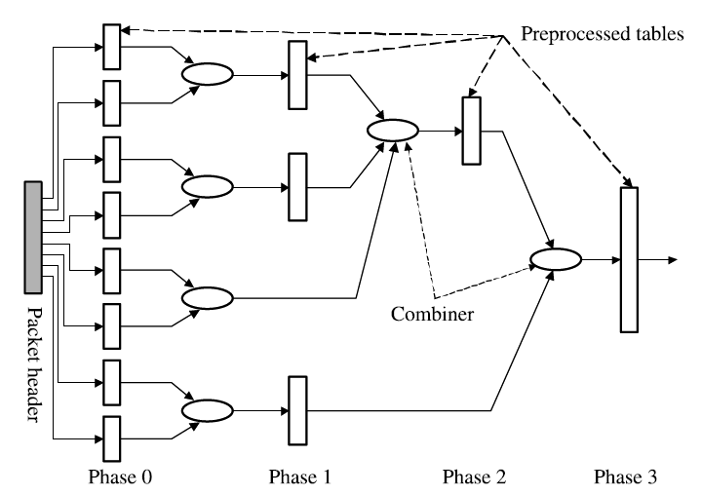
Recursive Flow Classification

Slide 31
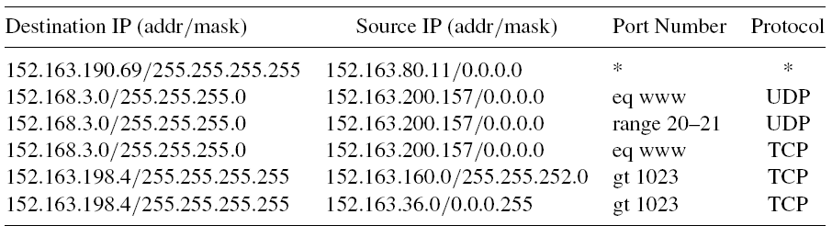
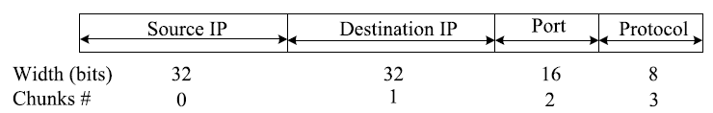
Recursive Flow Classification
Rule Set Example

Slide 32
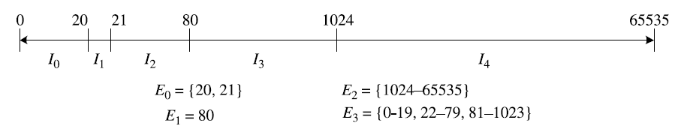
Recursive Flow Classification
Chopping of packet header into chunks for rule set C in the first phase of RFC.
Example of computing the four equivalence classes E0 . . . E3 for chunk 2 (corresponding to the 16-bit transport-layer destination port number) in the rule set of the classifier.

Slide 33
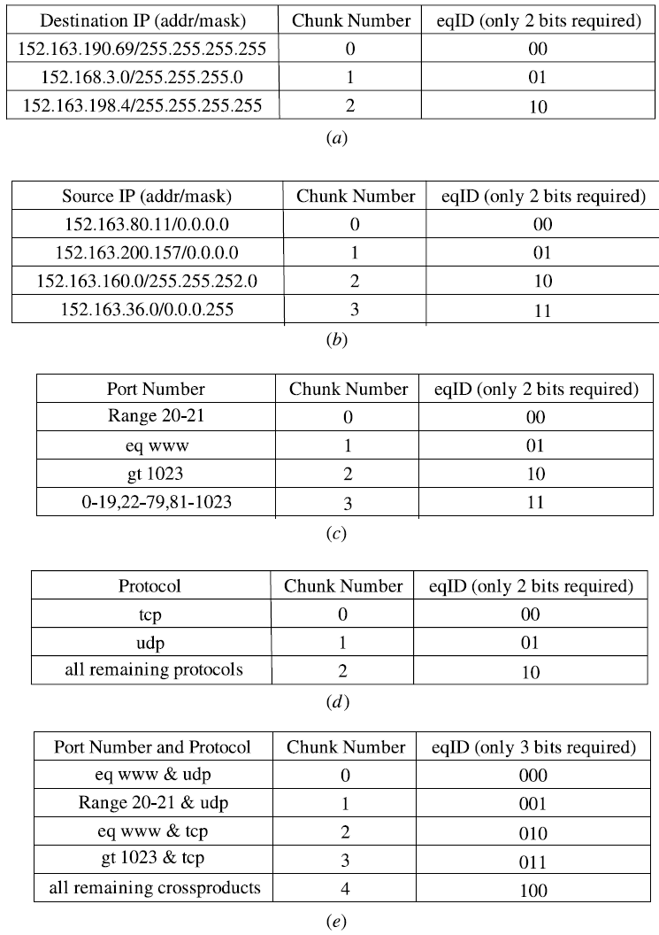
Rule storing organization for RFC for the rule set in the classifier table.
Destination IP field made into chunks and epIDs.
Source IP field made into chunks and eqIDs.
Port number field made into chunks and eqIDs.
Protocol field made into chunks and eqIDs.
Port number and protocol fields combined and made into chunks and eqIDs.

